Slide 1

Twitter Sentiment Analysis
Luca Matteucci, Neeharika Kamireddy, Sneha Jayapradeep, Haaniya Umair, Chirayu Jain

Slide 2
Understanding the Problem
Importance of Social Media Datasets
Categorization of Sentiment Data
Project Objective: Unsupervised ML
Datasets provide vast public opinions that are crucial for understanding prevailing attitudes, emotions, and opinions; manual analysis impractical.
Categorizing sentiment data into clusters enables a deeper exploration of sentiment dynamics across diverse subjects.
Objective is to use unsupervised ML to enhance our understanding of public opinion dynamics and gaining valuable insights from the data.
Notes:
Importance of Social Media Data: Social media platforms provide a vast amount of public opinions, crucial for understanding prevailing attitudes, emotions, and opinions. However, the sheer volume of data makes manual analysis impractical, necessitating the use of machine learning techniques.
Categorization of Sentiment Data: Categorizing sentiment data into clusters enables a deeper exploration of sentiment dynamics across diverse subjects. Unsupervised machine learning techniques play a crucial role in this process by automatically identifying inherent sentiment groupings in the data.
Objective of the Project: The primary objective of this project is to explore and utilize unsupervised machine learning techniques to uncover these inherent sentiment groupings in social media data. By doing so, we aim to enhance our understanding of public opinion dynamics and gain valuable insights from the data.

Slide 3
Our Dataset
Our dataset contains Tweets recorded on Twitter from April to June 2009
Columns such as Polarity, DateTime, Username and Content of the tweet
1,600,000 rows and 6 columns
Unclean dataset so had to perform text cleaning and preprocessing

Slide 4
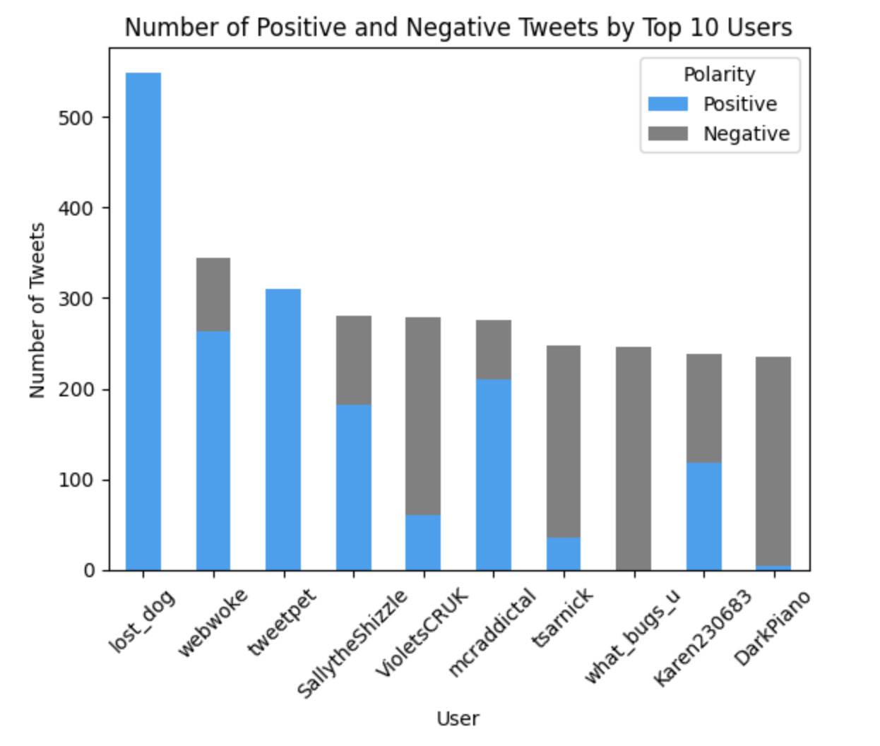
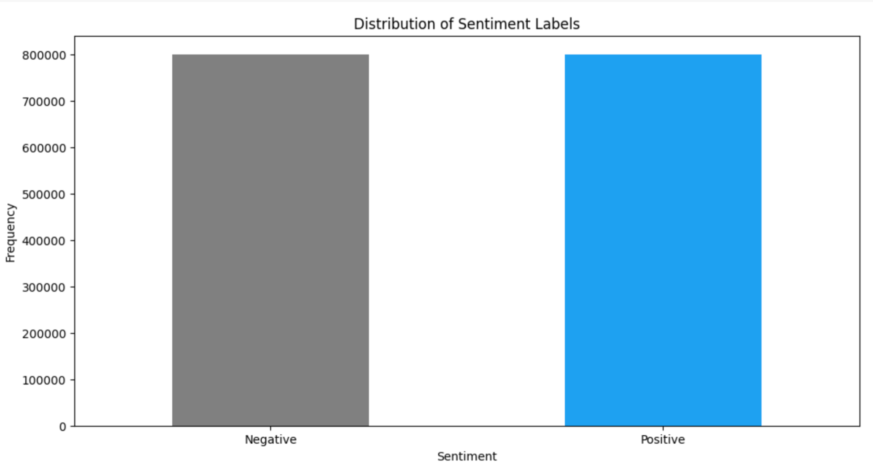
Exploratory Data Analysis
We have an equal number of positive and negative reviews, this means our dataset is balanced in terms of these two classes, but it does not provide information about the presence of neutral tweets or potential misclassifications. The top 10 users have predominantly positive reviews.

Slide 5
Sentiment Analysis Results
Tweets correctly classified
Misclassified tweets
✅
😊
❌
i gotta be great i have to everyday is a lessons to me
some italian like me prefer obama but unfortunately we have berlusconi
this sucksssssss
kevinspacey u look gr8 2nite mr spacey on the swedish show gr8 impressions of mr clinton amp mr pacino (borderline score)
crying my f*****g eyes out yeah i am really f*****g happy ughh (very hard to classify without human eye)
youre welcome (0,0 similarities)
😡
✅
😡
❌
😡
✅
😡
❌
😡
Borderline tweets
Scoring compared to given labels
❌
😡
4 hours boom boom (0,0 similarities)
got the transformers song going through my head good time to go to sleep i guess
again but now with picture
✅
45K
😊
0.508
0.529
✅
😡
F1 - Pretrained Model
F1 - Word2Vec

Slide 6
Challenges
Computational Resources
Potential previous misclassification of tweets
01
02
Resource constraints hindered accurate processing of 1.6M tweets
Labels may not accurately reflect sentiment, including neutral tweets misclassified as positive or negative.
Sentiment Lexicon
Dataset from 2009
03
Difficulty in creating an accurate, relevant, and comprehensive list of words for classifying tweets as positive or negative
04
Our pretrained model was from more recent years, and it was difficult to correctly preprocess ‘old school emojis’

Slide 7
Real World Applications
Customer Feedback Analysis
Brand Monitoring
Market Research
Used for real-time analysis of customer feedback to identify trends and insights
Monitor social media for brand sentiment, enabling timely responses to feedback
Apply sentiment analysis for consumer insights in product and marketing decisions

